Slide 1
RESNET – Residual Networks
Vignesh R

Slide 2
Why ResNet?
- Researchers observed that it makes sense to affirm that “the deeper the better” when it comes to convolutional neural networks.
- However, it has been noticed that after some depth, the performance degrades due to Vanishing Gradient Problem
- The core idea of ResNet is that it introduced a so-called “identity shortcut connection” that skips one or more layers to resolve vanishing gradient problem.
- With ResNets, the gradients/weights can flow directly through the skip connections backwards from later layers to initial filters.
Resnet Versions:
ResnetV1 Paper - Deep Residual Learning for Image Recognition
ResnetV2 Paper - Identity Mappings in Deep Residual Networks

Slide 3
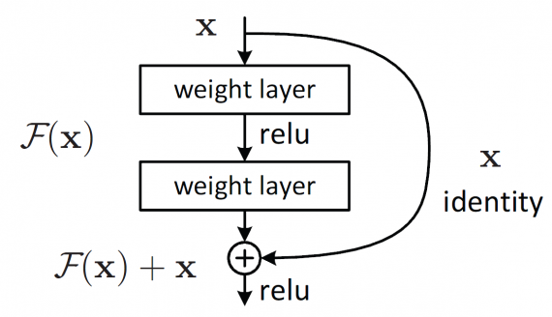
Residual Block
- The basic building blocks of a residual neural network are the so-called residual blocks. The basic idea here is that so-called “skip connections” are built into the network.
-> Residual learning = F(x) + x
- x is an input to the residual block and output from the previous layer
- F(x) is part of a CNN consisting of several convolutional blocks.
- This technique smooths out the gradient flow during backpropagation, enabling the network to scale to 50, 100, or even 150 layers. Skipping a connection does not add additional computational load to the network.
- This technique of adding the input of the previous layer to the output of a subsequent layer has been applied to many other neural network architectures including UNet and Recurrent Neural Networks (RNN).

Slide 4
Types of ResNet
Input shape to model – (224, 224)
There are five major type of resnets based on number of layers used in network architecture.
1. ResNet18,
2. ResNet34,
3. ResNet50,
4. ResNet101,
5. ResNet152
ResNet50
- It consists of 50 layers and achieved state-of-the-art performance on the ImageNet dataset in 2015.
- ResNet50 consists of two kinds of blocks:
- Identity block
- Convolutional block

Slide 5
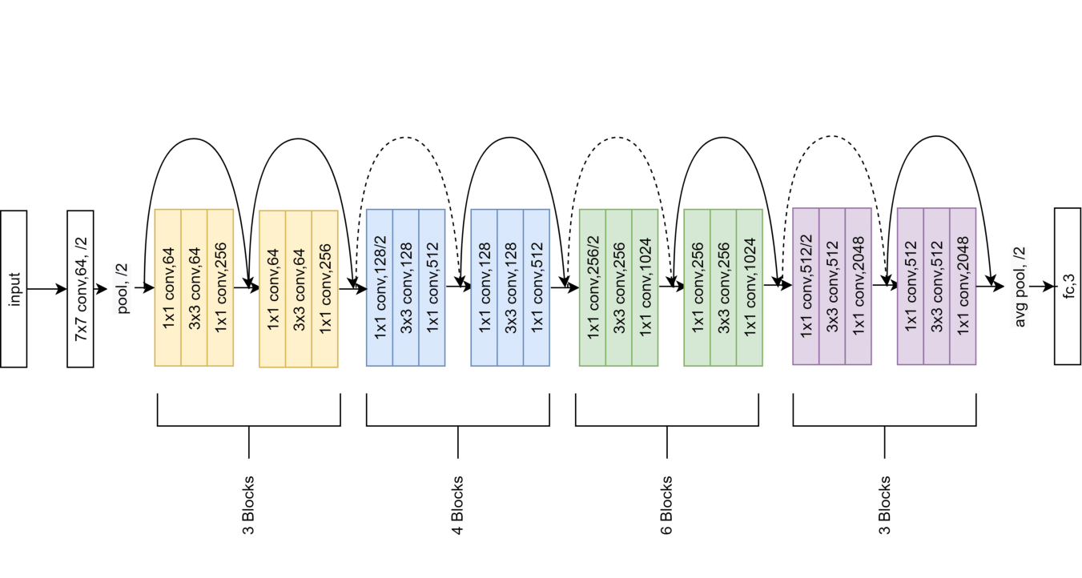
ResNet50 workflow diagram

Slide 6
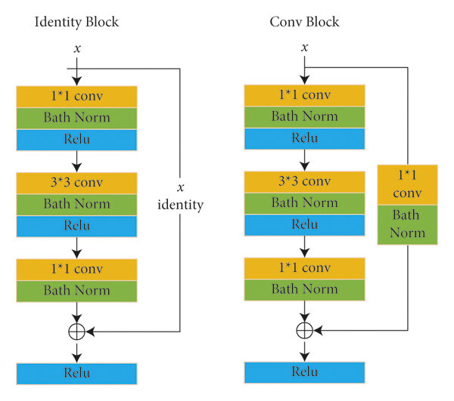
Types of Resnet blocks
- Dotted line in flow diagram represents change in dimensions of input volume
- The convolutional block is used whenever there is need to change the dimension in order for the output and input dimensions to match (ie change in input and ouput dimensions).
- Identity Block is used when there is no change in input and output dimensions.

Slide 7
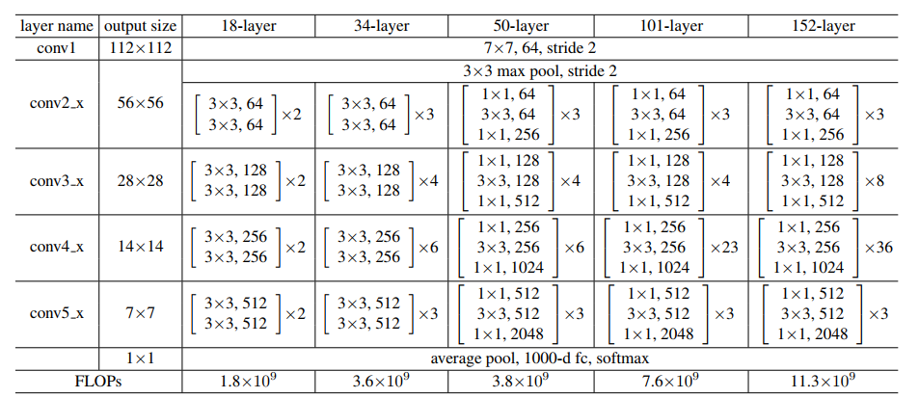
ResNet Types Comparison

Slide 8
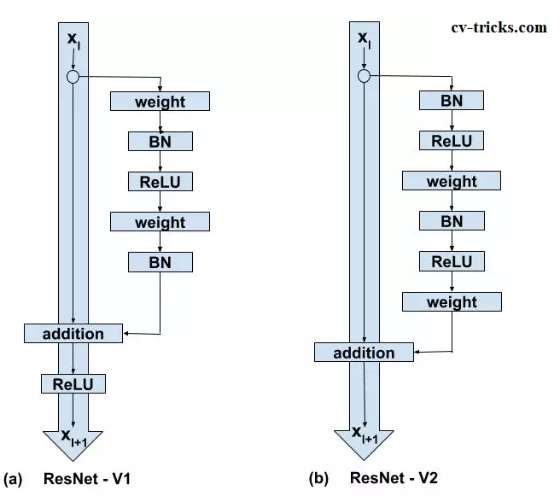
ResnetV1 vs ResnetV2
- ResNet V1 adds the second non-linearity after the addition operation is performed in between the x and F(x). ResNet V2 has removed the last non-linearity, therefore, clearing the path of the input to output in the form of identity connection.
- ResNet V2 applies Batch Normalization and ReLU activation to the input before the multiplication with the weight matrix (convolution operation). ResNet V1 performs the convolution followed by Batch Normalization and ReLU activation.

Slide 9
Calculate output layers
- There are 2 ways to make the input size equal to the output size
- Padding the input volume(W,H) -> Maintains image dimensions(height and width)
- Performing 1*1 convolutions -> Maintains Channel dimensions
- Size of output layer is calculated using
{ (n+2p-f) / s } + 1
n = input image size,
p = padding,
s = stride,
f = number of filters.
For, 1*1 convolutional layers, size of output layer = (n/2) x (n/2) given the input size is ‘n’.

Slide 10
References
- Detailed Guide to Understand and Implement ResNets
- Understanding and visualizing ResNets
- Build ResNet from Scratch With Python
- Detailed Explanation of Resnet CNN Model
- ResNet: Residual Neural Networks – easily explained!
- Writing ResNet from Scratch in PyTorch
- Understanding and implementation of Residual Networks(ResNets)
- ResNet: The Basics and 3 ResNet Extensions

